Slide 1

Week 12 PSLG Session (the last one for this semester ☹)
Hosted by : Ben & Amy

Slide 2
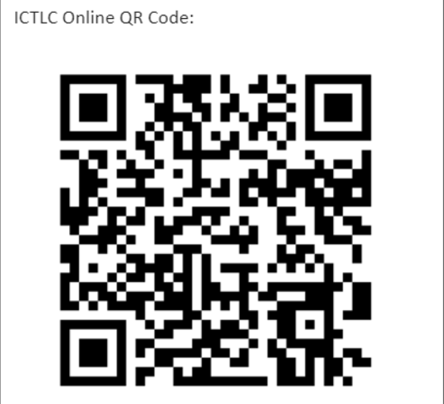
DLSH:

Slide 3
Agenda
Sorting Algorithms:
- What are they?
- Bubble sort
- Selection sort
- Insertion sort

Slide 4
What is a sorting algorithm
A sorting algorithm is a means of sorting a list of data based off a specific criteria
i.e. sorting a list of numbers from largest to smallest
Or sorting a bag of M&Ms based off their colours.
For us this means using a combination of conditional statements and iteration to sort a list

Slide 5

What is a sorting algorithm
The sorting algorithm we use in our code usually depends on two things
1. The volume of data we have to sort and 2. the time complexity of the algorithm used.
These are important things to know but not completely understand yet just know they are factors that affect what algorithm we use
And so with that covered we’ll now move onto explaining and getting you to implement some algorithms

Slide 6
Note before the problems
This PSLG session is going to take a unique twist where I will give you the idea of the sort and you will try to recreate it in java, after which I will show you the standard implementation.
For each of these problems we will work with the same sample code which is an array of size 10 with random numbers from 1 to 20 and create int[] methods to hold our sorting algorithm code.

Slide 7
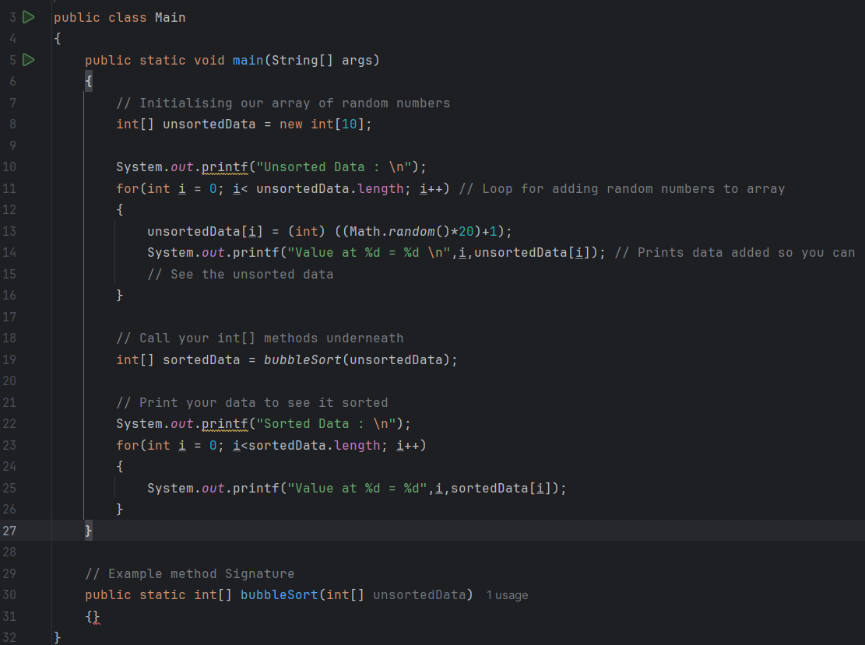
Example

Slide 8
Bubble sort
Bubble sort steps through each index of the unsorted data.
It compares the current index and the next, if the current index is greater than the next it swaps them otherwise it does nothing.
This sort must run until all data is sorted.

Slide 9
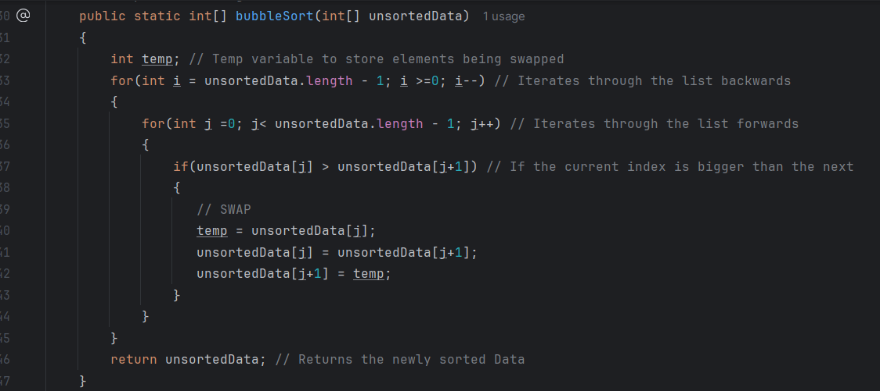
Bubble sort: Optimal Solution

Slide 10
Selection Sort
Combines searching and sorting.
The smallest element in the array is searched for,
When it is found it is moved to its proper position
If it's already in its proper position you do nothing.
(The first time the loop is run it will move the smallest element to the first index, then the second etc.)

Slide 11
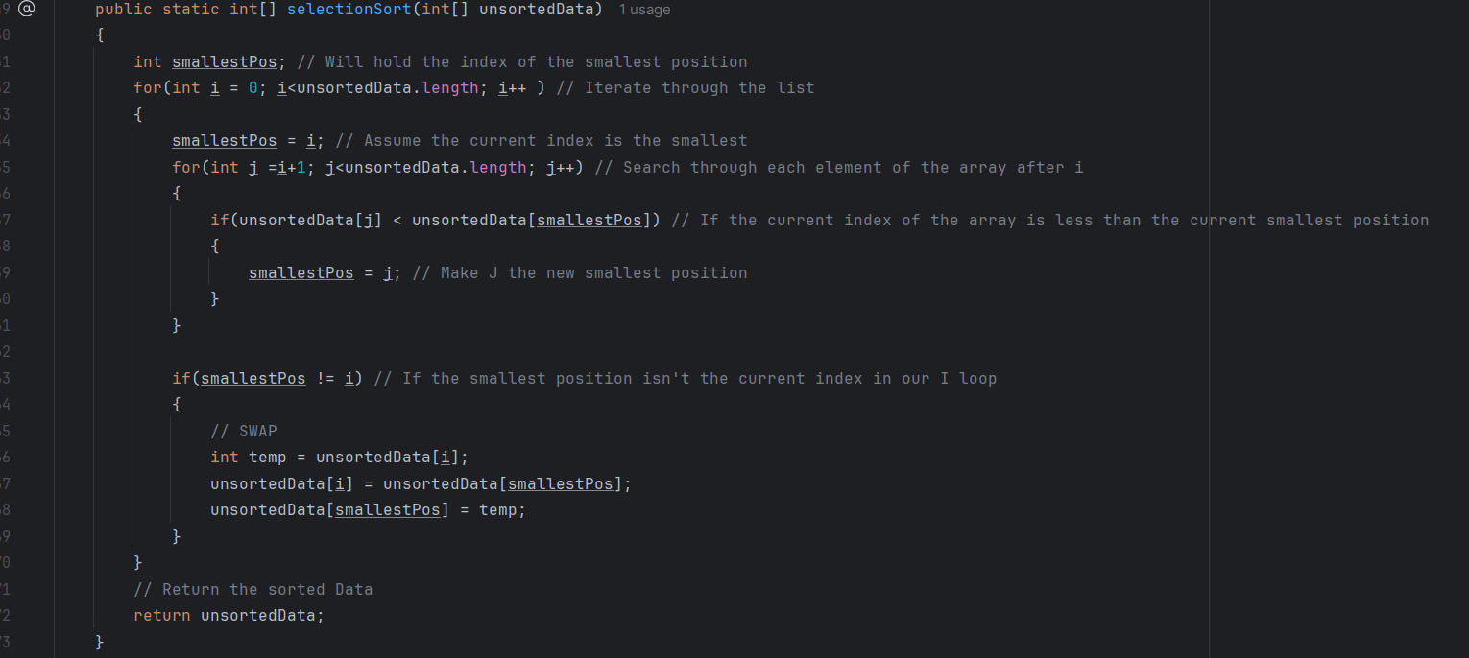
Selection sort: Optimal solution

Slide 12
Insertion sort
Similar to bubble sort but with a key difference.
This algorithm iterates through the list comparing the current element to all previous elements.
If the current element is less than the any of the previous it swaps them. Otherwise it does nothing.

Slide 13
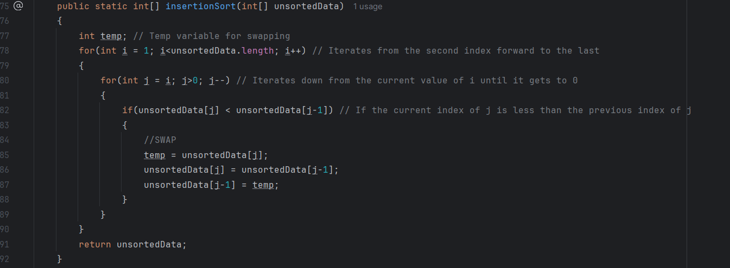
Insertion sort: Optimal Solution

Slide 14

Fine

